Slide 1
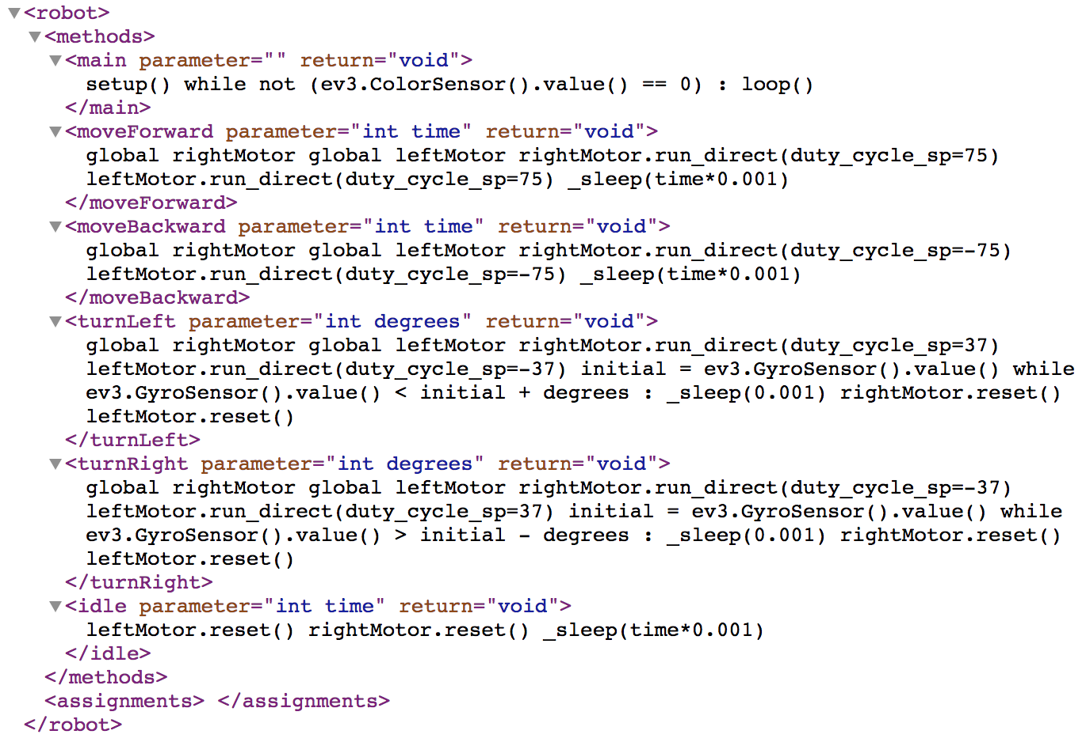
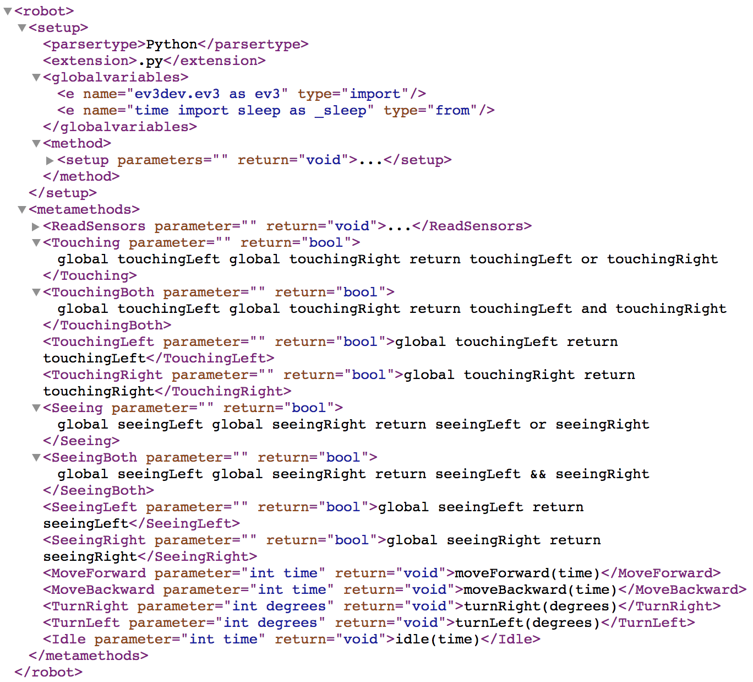

Slide 2
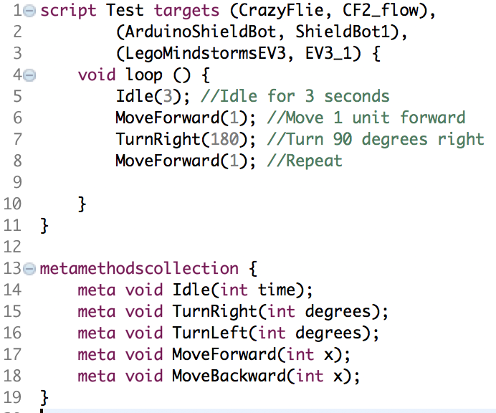
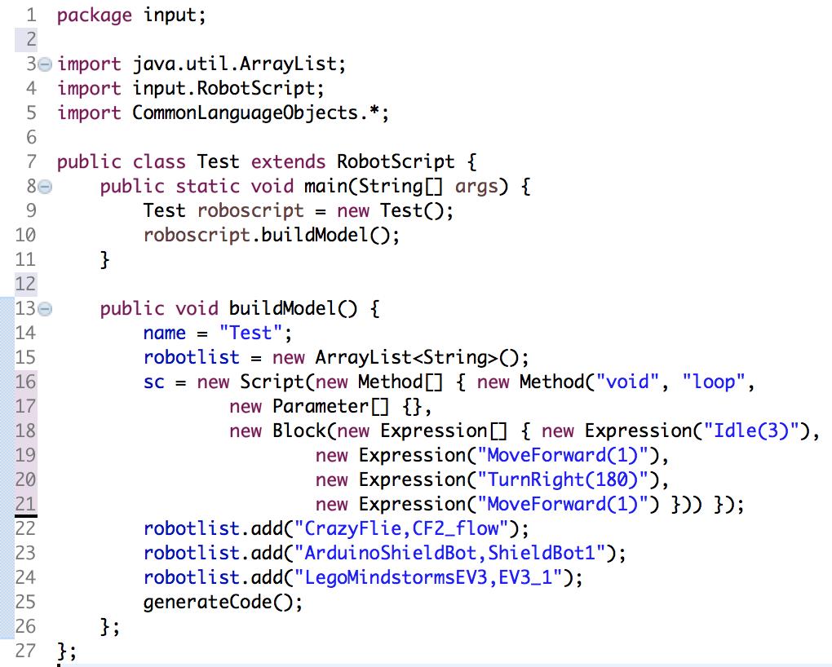
Test.commonlang
LegoMindStormEV3.xml
EV3_1.xml
Test.java
Test.c
Test.py

Slide 3
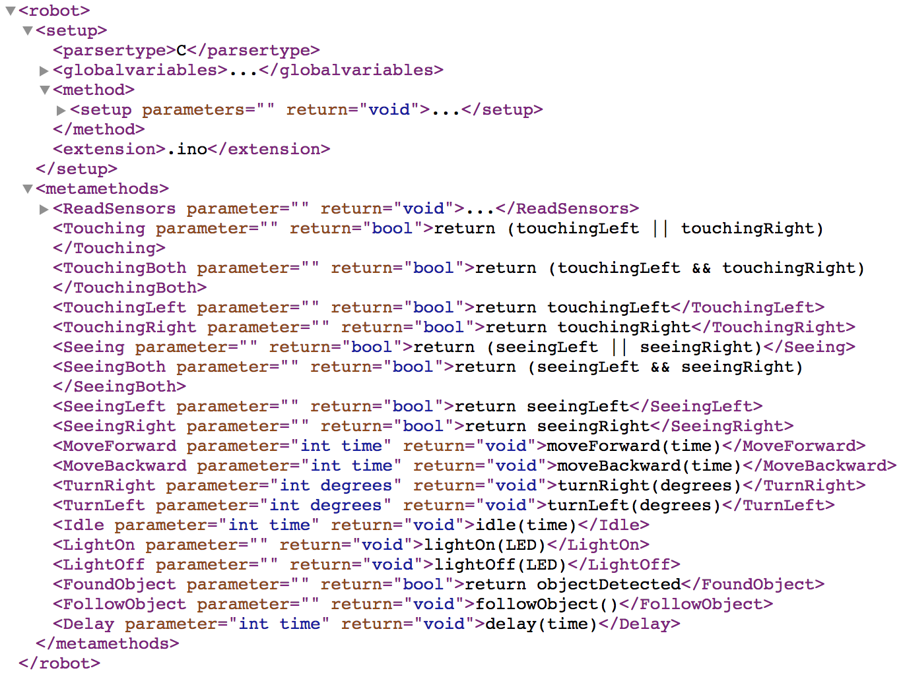
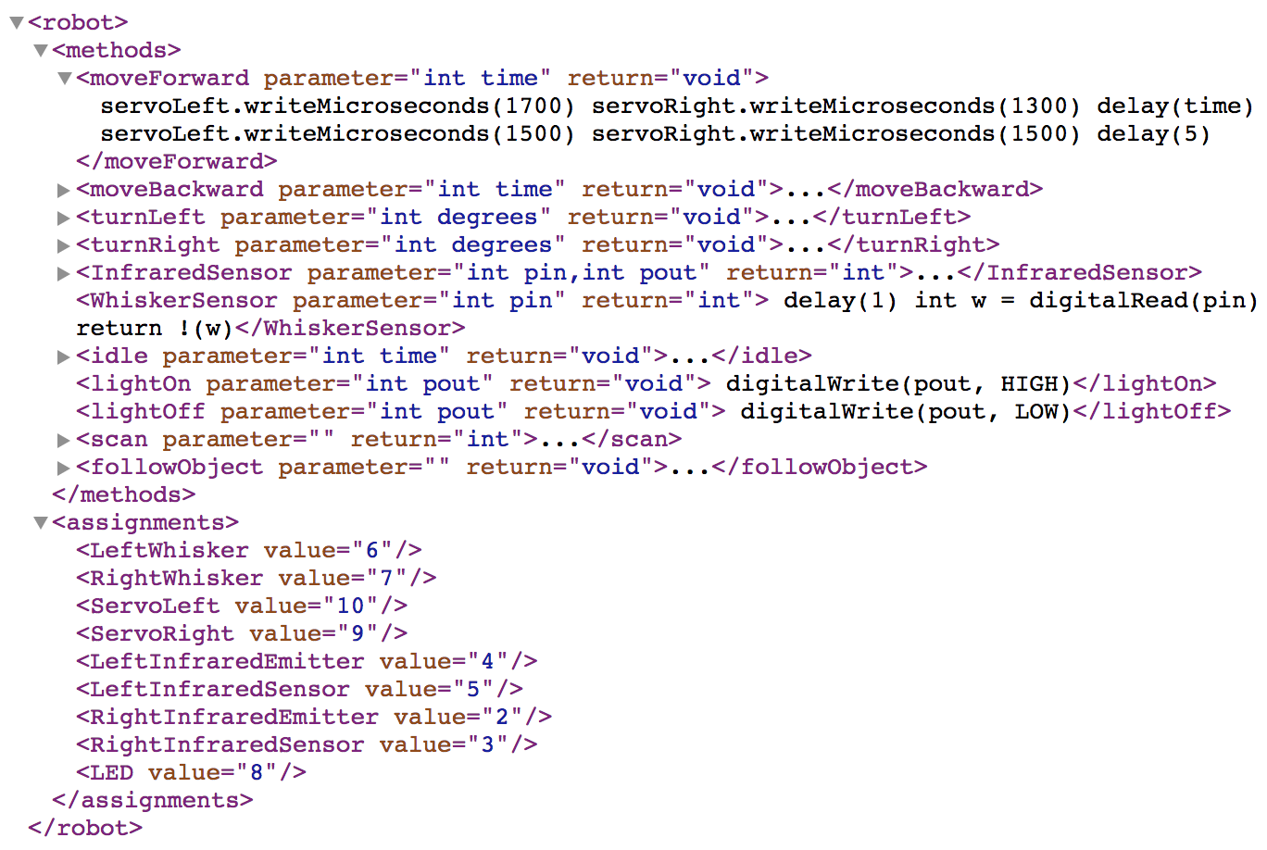
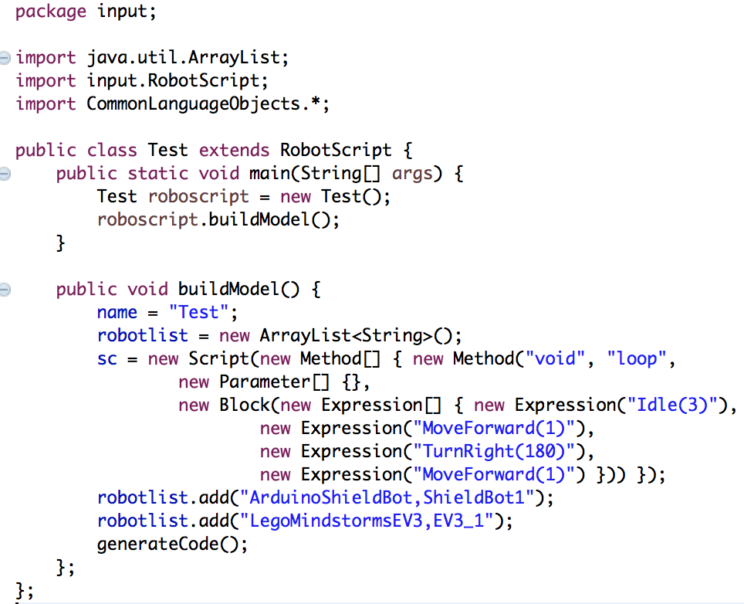
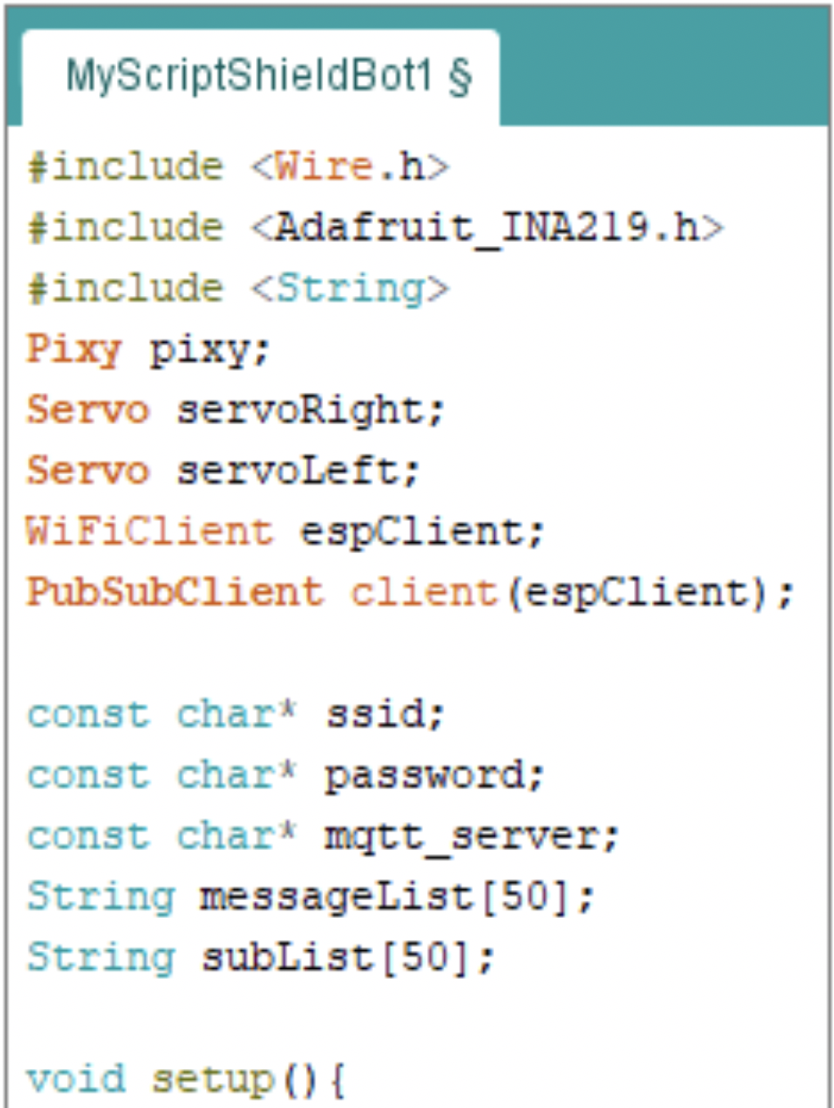
General for Arduino (XML)
Specific to our Arduino robot (XML)
Generator code (Java)
Arduino script

Slide 4
General for Arduino (XML)
Code generator (Java)
Specific to our Arduino robot (XML)
Arduino script

Slide 5
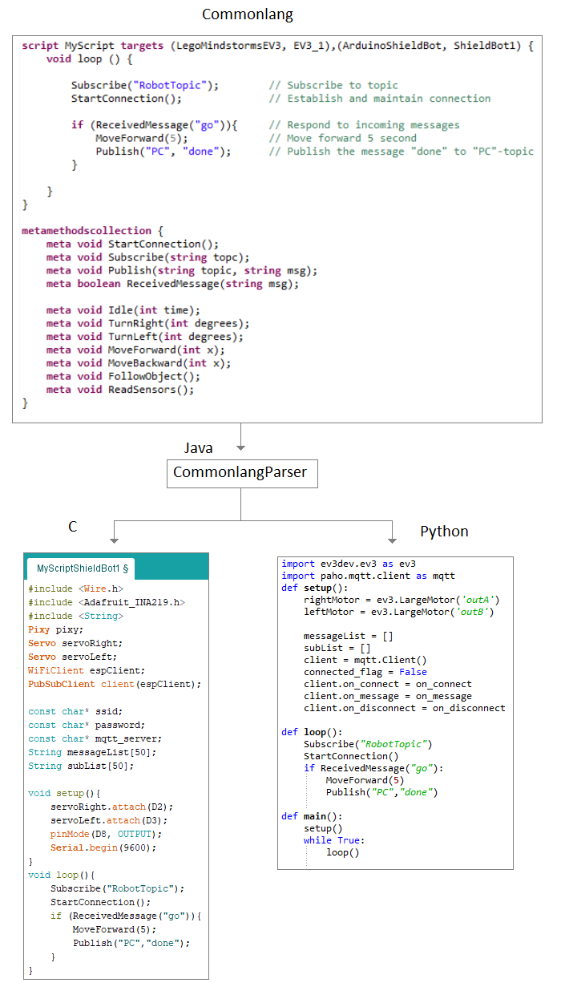

Slide 6
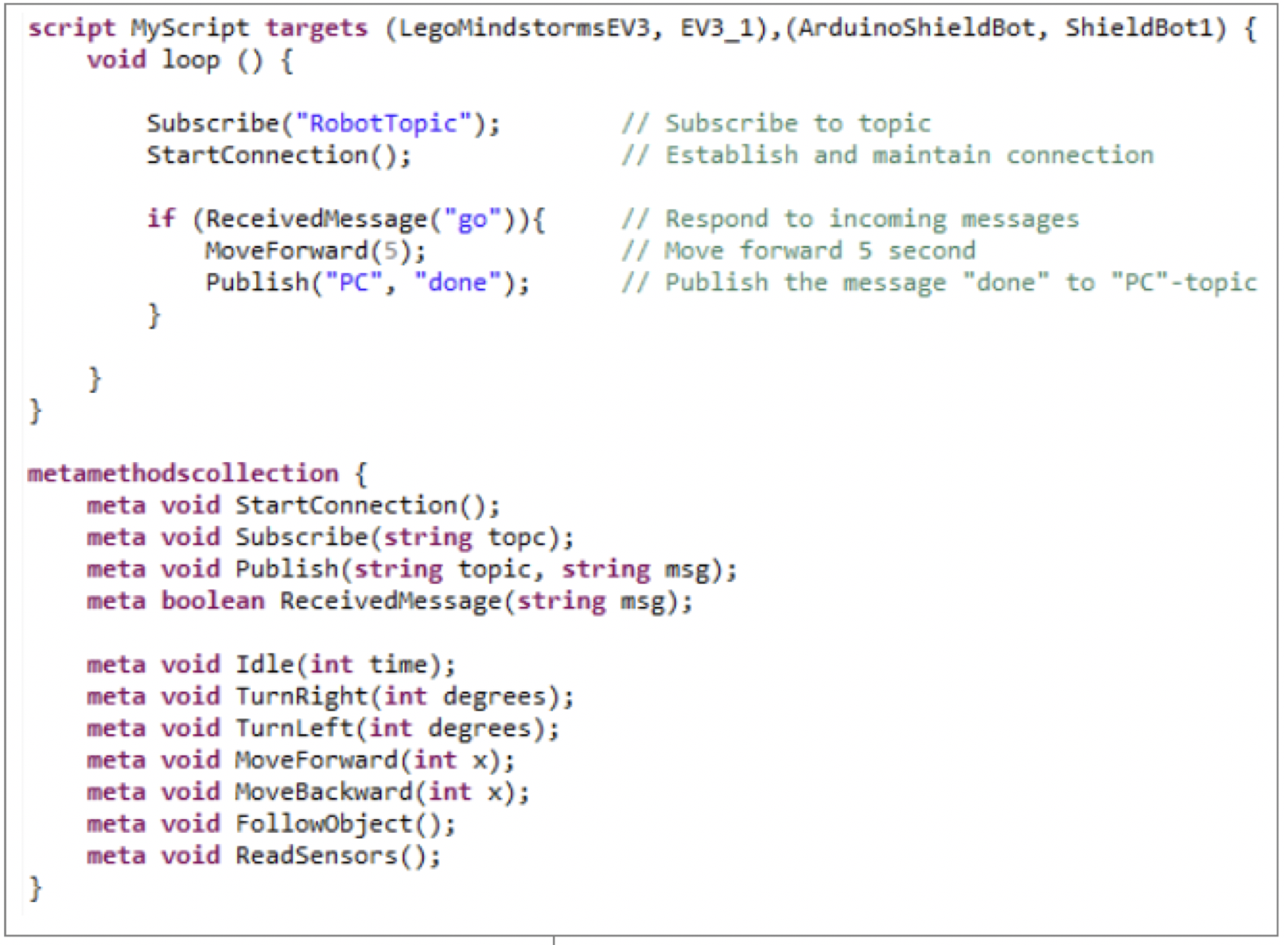
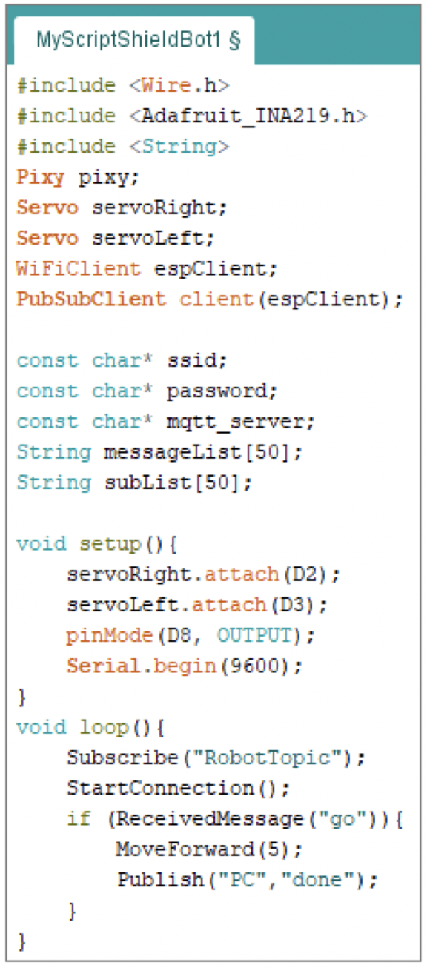
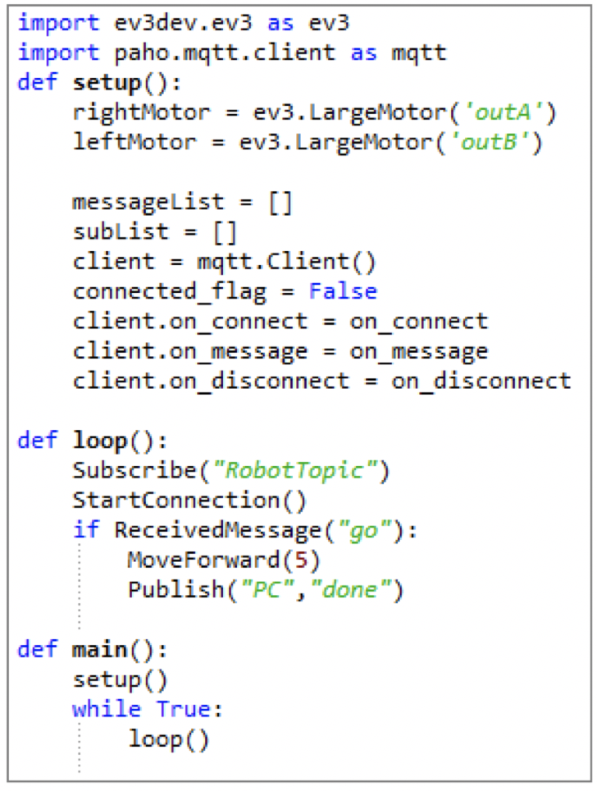
CommonLang script
Arduino script
Python script

Slide 7
CommonLang: a DSL for defining robot tasks
Adrian Rutle, Jonas Backer, Kolbein Foldøy and Robin T. Bye
MORSE 2018

